Slide 1
ENCAPSULATION

Slide 2
ENCAPSULATION
Wrapping up of data under a single unit
A protective shield that prevents the data from being accessed by the code outside this shield
Encapsulation can be achieved by:
Declaring the variables of a class as private.
Providing public setter and getter methods to modify and view the variables values.

Slide 3
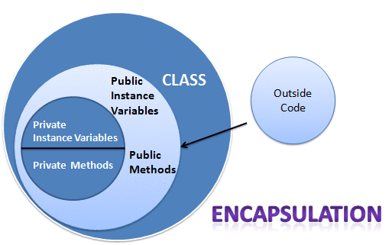

Slide 4
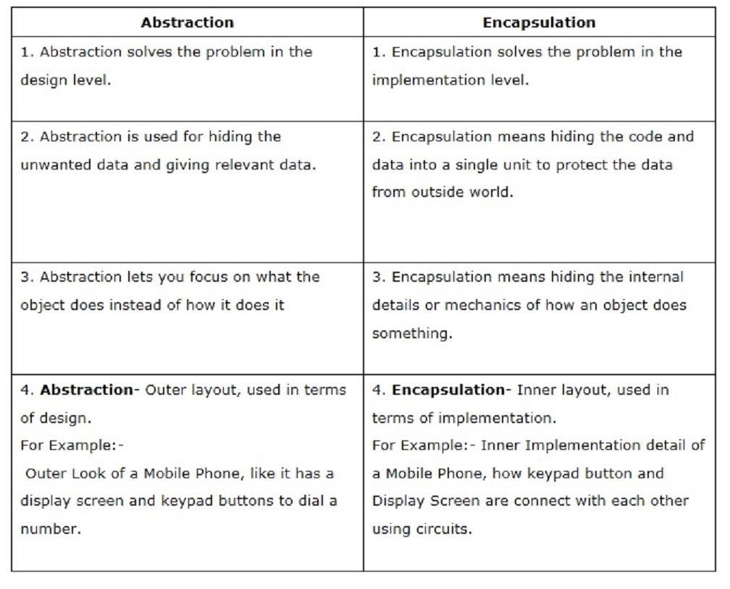

Slide 5
EXAMPLES

